Slide 1
CSS 497 2018 Capstone Hyper parameter selection with Genetic Algorithm with Reinforcment learning
Danny Ly
Advisor: Dong Si
Computer Science and Software Engineering

Slide 2

Motivation
Goal since admissions to CS at UWB to get closer to working with Artificial Intelligence
Relevance: Bigger step towards my career goals in Machine learning

Slide 3
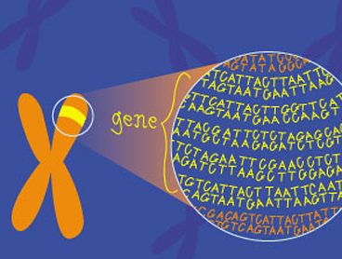
Purpose
Explore what ‘genetic algorithms’ meant
Apply their use to a practical real-world problem
Combing Neural Network’s, Reinforcement Learning, and Genetic Algorithms

Slide 4
Genetic Algorithms
A. Genetic Diversity
Initial Population
B. Evaluate Fitness
5 Rounds of Ping-Pong
E. Next Generation
Repeated Process
D. Reproduce
Breed & Mutate Survivors
C. Selection
Kill Unfit Networks

Slide 5
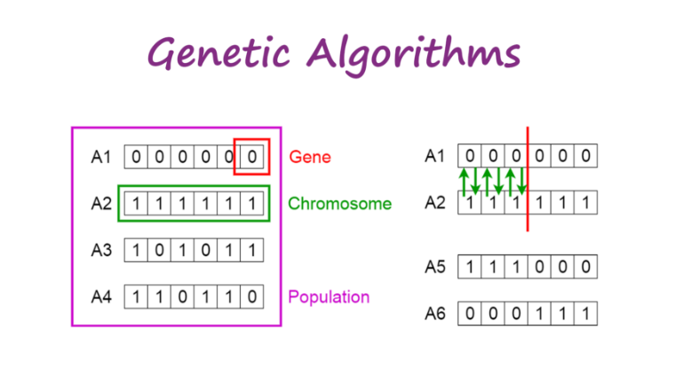
Genetic Algorithms?
Search Heuristic , natural evolution.
Offspring will be better than parents
Mutations

Slide 6
Genetic Algorithms and Hyper parameters
Hyper Parameters are the configurations of a Neural Network
Complex networks can have millions
#hid neuron, Learning rate, Decay rate and weights
Solving both constrained and unconstrained optimizations progblems, based on natural selection, modifies a population of individual solutions

Slide 7
Uses?
Complex problems with a large multitude of hyper parameters to choose from and optimize
Hyper parameters
Variables which determines the network structure, which paramters are the best
Instead of a single parameter tuning we tune many parameters at once

Slide 8
Policy Gradients
Forward Policy
Backward Policy

Slide 9
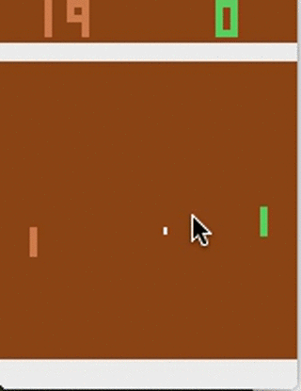
Problem
Given an interface to send keys (up, down, none) to a program, can this program learn to play ping pong adequately, based off rewards?

Slide 10
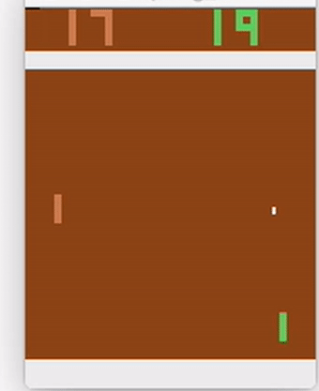
Goal
Using Genetic algorithms find the best hyper parameters that will allow this program to adequately play against another computer.

Slide 11
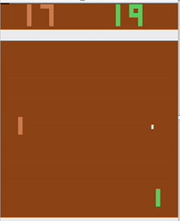
Design Approach
Pixels of the game board
Hidden Layer
Probability of Moving up, down, or not at all
Image Classification
Aims at turning on specific Neurons

Slide 12
Genetic Algorithm program flow
Initial Neural Network Population
Network Plays in their on environments
Pick Two top Performing Networks
Breed Top performers together
Combine Top Performers, their spawn, and mutated Networks into Population
Remove 50 % of population and the remaining Networks

Slide 13
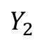
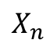
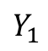
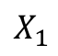
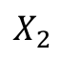
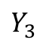
Neural Network Architecture
Input Layer
Hidden Layer
Output Layer
$$X_{1}$$
Σ
Σ
Σ
$$Y_{1}$$
$$X_{2}$$
Σ
Σ
Σ
$$Y_{2}$$
Network Outputs
Network inputs
Σ
$$Y_{3}$$
$$X_{n}$$
Σ
Σ
Neuron
Bias
1
1

Slide 14
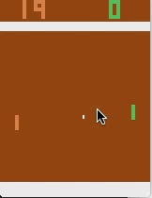
Pre-Trial Results
Green Is Network, first Model made
Model was stuck at the top or stuck at the bottom

Slide 15
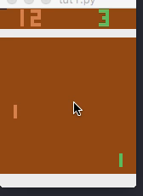
Post-Trial Result
Green is the Model playing adequately well
After changing the model to use a softmax activation function the paddle is more stable

Slide 16
Application(TO REMOVE)
Computer Gaming
Manufacturing
Robotics
Engineering Designs

Slide 17
Summary

Slide 18
Thank you
Questions?
References

Slide 19
Lessons Learned
Genetic Algorithms purpose for parameter searching
Hands on experience with machine learning data pipeline

Slide 20
Tools
Python
OpenAI Gym
GitHub
Docker
Digital Ocean
Numpy

